Slide 1
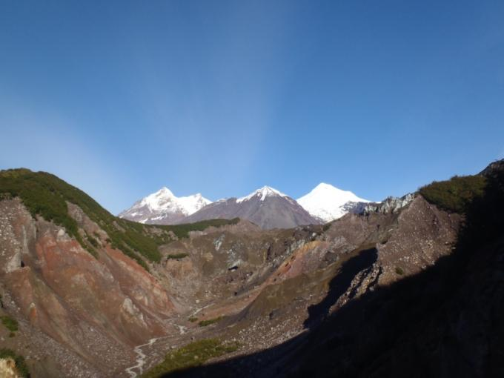
Ormat Technologies, Inc.
Geothermal Resource Definition at Mt.Spurr, Alaska
Brigette A. Martini, Chet Lide, Lara Owens, Patrick Walsh, Ben Delwiche and Allison Payne

Slide 2
Disclaimer
Statements in this presentation as well as oral statements made by the officers or directors of Ormat Technologies, Inc., its advisors, affiliates or subsidiaries often will contain “forward-looking statements.” Whenever you read or hear a statement that is not simply a statement of historical fact (such as when we describe what we “believe”, “expect” or “anticipate” will occur, and other similar statements), you must remember that our expectations may not be correct, even though we believe they are reasonable. You should read and listen to these statements completely and with the understanding that actual future results may be materially different from what we expect, as a result of certain risks and uncertainties. For a complete discussion of the risks and uncertainties relating to the forward-looking statements in this presentation, please see “Risk Factors” as described in the Annual Report on Form 10-K report filed with the Securities and Exchange Commission on 28 February 2011.
We will not update these forward-looking statements, even though our situation will change in the future.

Slide 3
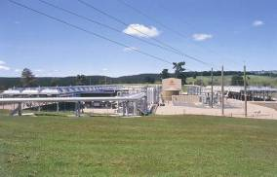
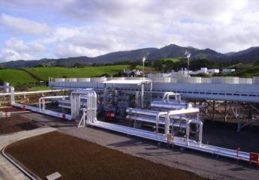
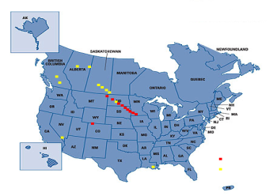
Ormat Technologies, Inc.
A pioneer and world leader in Organic Ranking Cycle (ORC) technology, with a focus on Geothermal and Recovered Energy Generation REG® power applications
Listed on the New York Stock Exchange (NYSE: ORA)
    Market cap: UPDATE
    Sales 2010: UPDATE
    Over 1,150 employees worldwide (~ 500 in U.S.)
Supplied 1,370 MW of geothermal and recovered energy power plants in 24 countries, owns and operates 553 MW generation worldwide
Vertically integrated
  R&D, engineering, manufacturing, installation, support & O&M
Equipment Supply, EPC, BOT or IPP
110 MW geothermal Combined Cycle Plant, New Zealand
10 MW Geothermal modular binary unit, San Miguel Island
145 MW of REG power plants in North America
Notes:
2

Slide 4
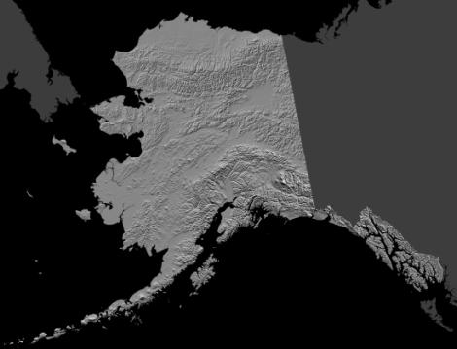
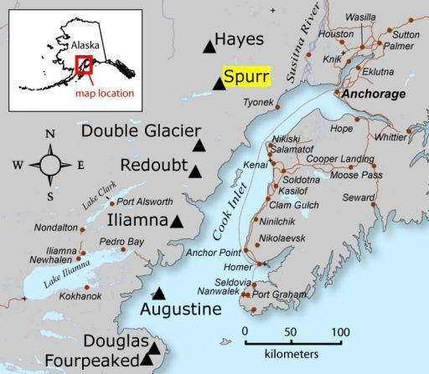
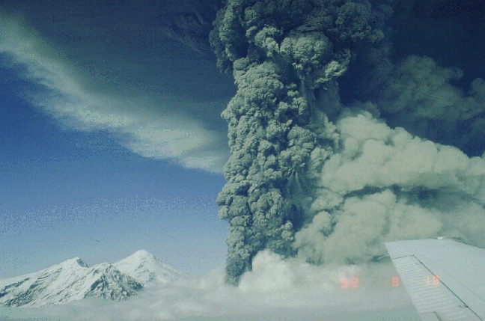
The Cook Inlet Volcanoes – Mt. Spurr
Primary bullet
  Sub bullet
Courtesy USGS
Mt. Spurr - 1992
Notes:
3

Slide 5
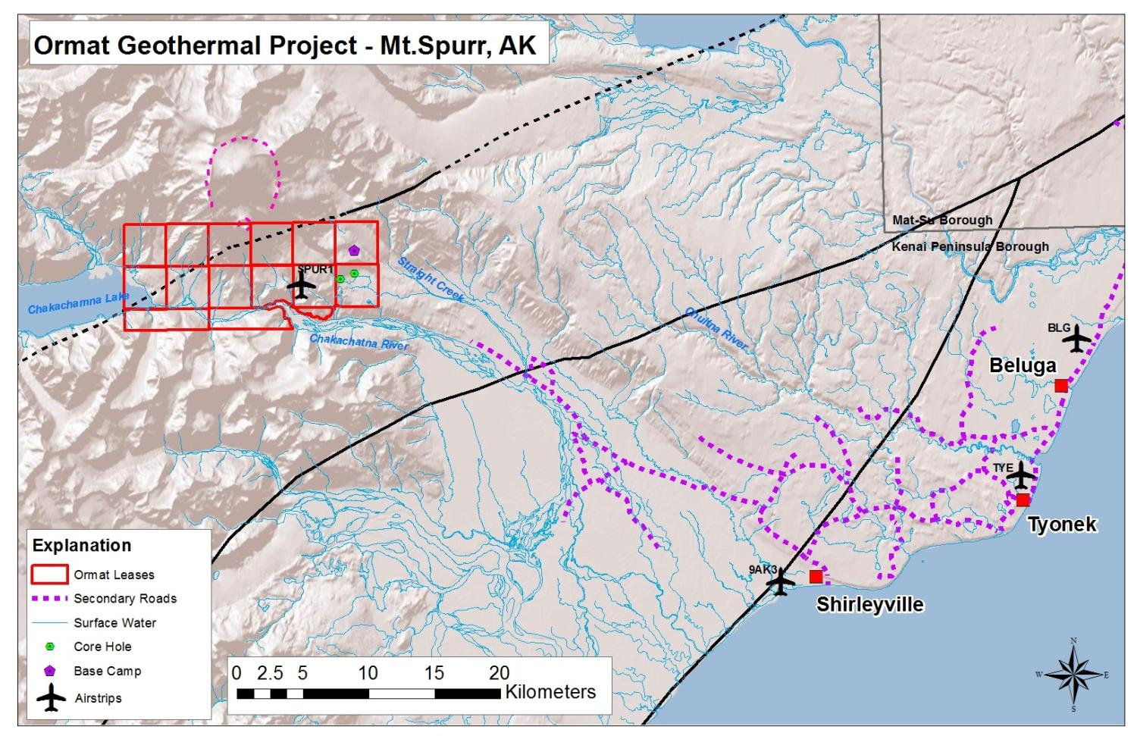
The Cook Inlet Volcanoes – Mt. Spurr
Primary bullet
  Sub bullet
Notes:
4

Slide 6
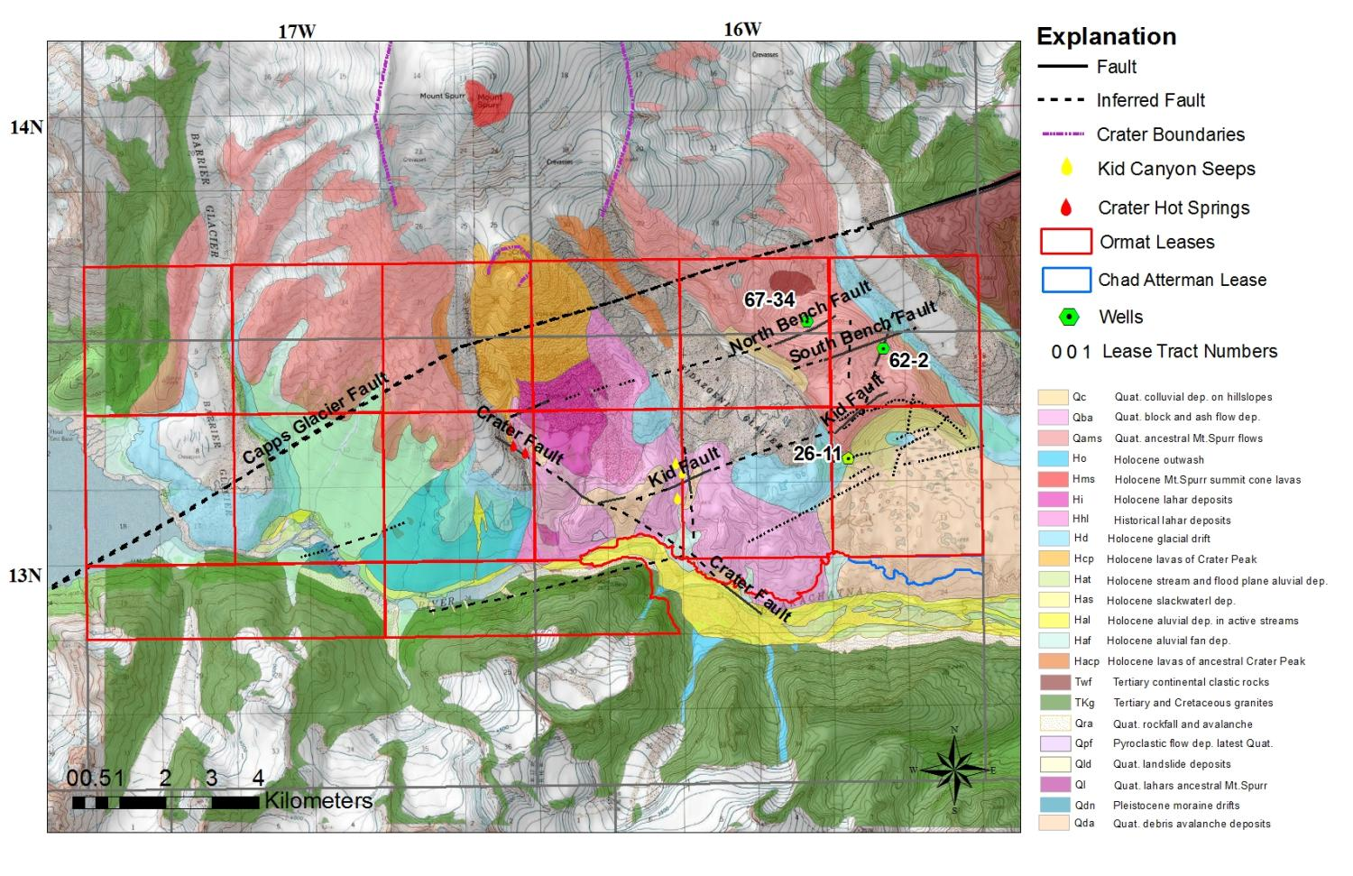
Basic Geology (after Nye and Waythomas, ‘05)
Primary bullet
  Sub bullet
Notes:
5

Slide 7
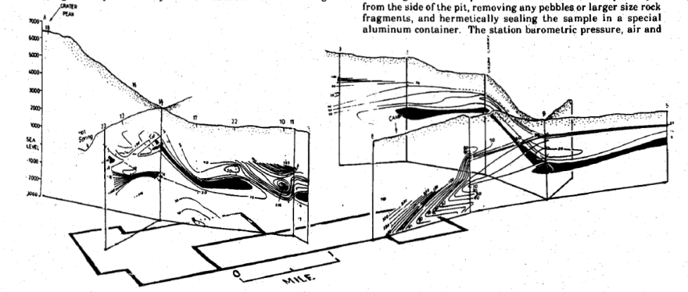
Previous Mt. Spurr Studies
Aqueous Geochemical Sampling
  Crater lake, springs and glacial outlfow (1970, 1985, 1992, 2005, 2006)
Geophysics/Soil Geochem (Wescott et al., 1988)
  SP
  CSAMT
  He & Hg Soil Gas
Basic geology
  Petrology
  Age-dating
  Volcanic strat.
  Hazard analysis
Wescott et al., 1988
Notes:
6

Slide 8
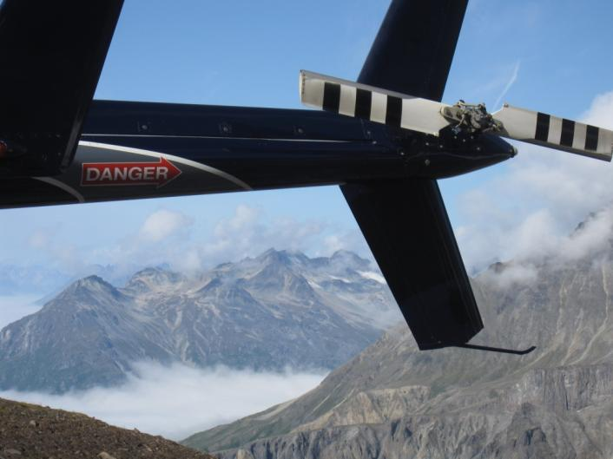
2009-2011 Exploration
Field Studies
  Mapping
  Aqueous geochemical sampling (bulk anion/cation)
Remote Sensing
  LiDAR (1m)
  Quickbird (0.6m)
Geophysics
  Heli-magnetics (1670 line km)
  Ground gravity (340 stations)
  Ground MT (49 stations)
Drilling
  (2) Shallow strat holes (~1000ft)
  (1) Intermediate depth TG hole (~4000ft)
Notes:
7

Slide 9
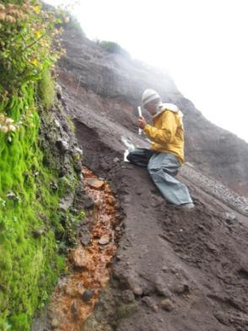
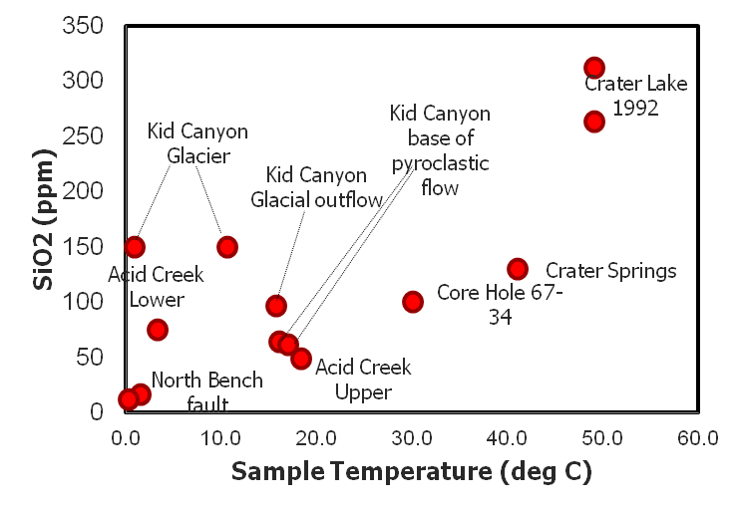
Geochemical Surveys
Bulk cation/anion analyses
Notes:
8

Slide 10
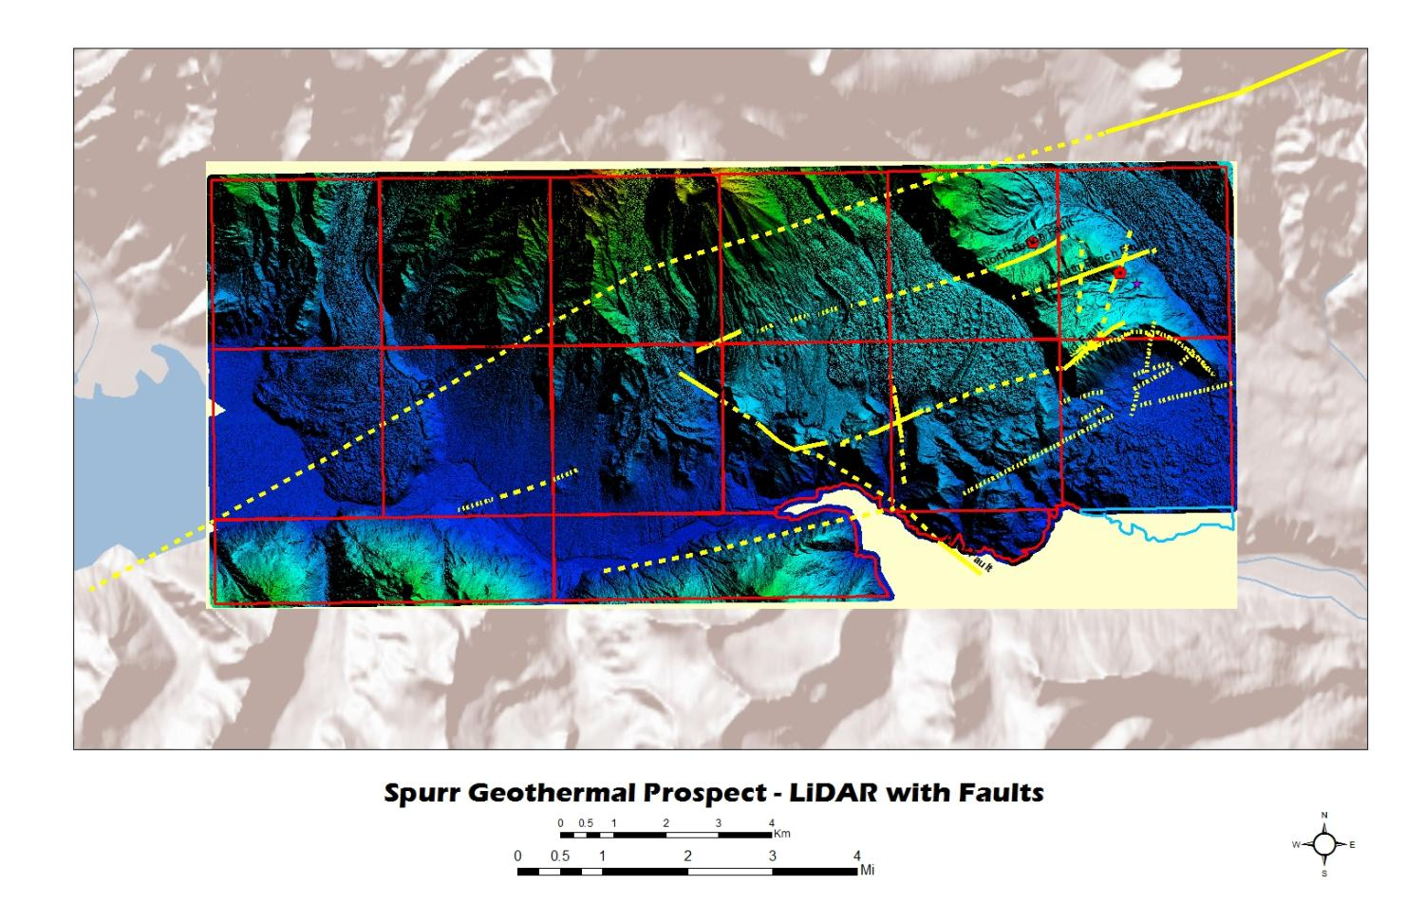
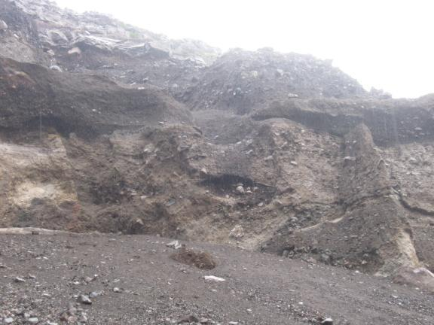
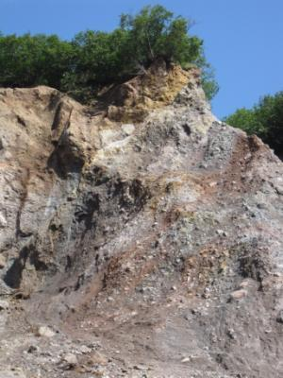
Surface Elevation – LiDAR (1m)
251, 75SE
295, 60NE
0.5 m LiDAR
Humboldt Valley, NV
Notes:
Characterize surface topography at fine scales; added bonus of vegetation penetration

Slide 11
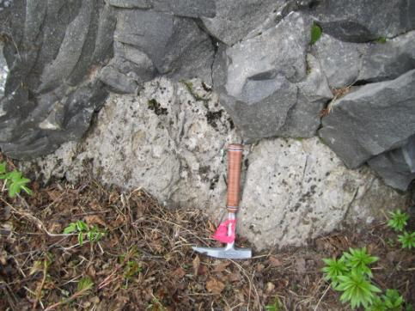
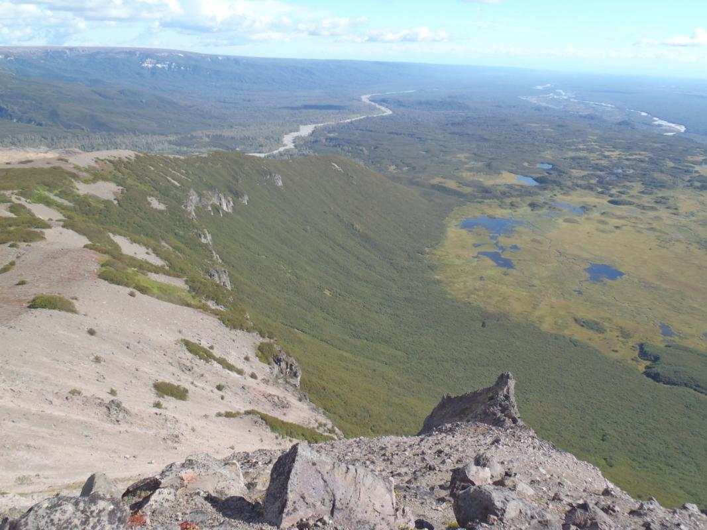
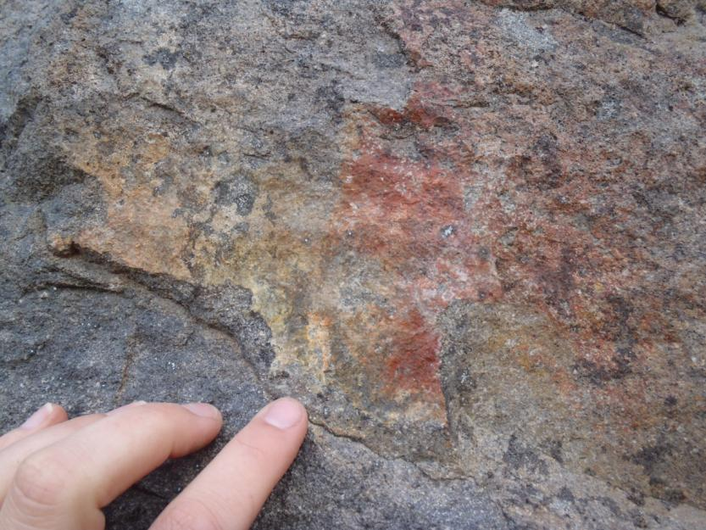
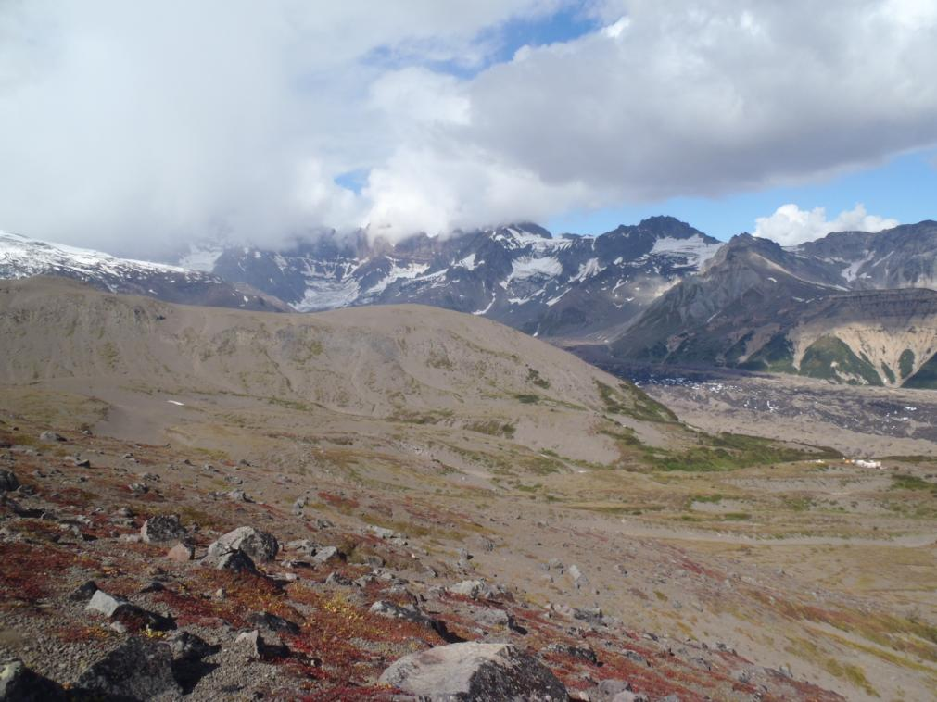
Surface Elevation – LiDAR (1m)
252, 71SE
0.5 m LiDAR
Humboldt Valley, NV
Notes:
Characterize surface topography at fine scales; added bonus of vegetation penetration

Slide 12
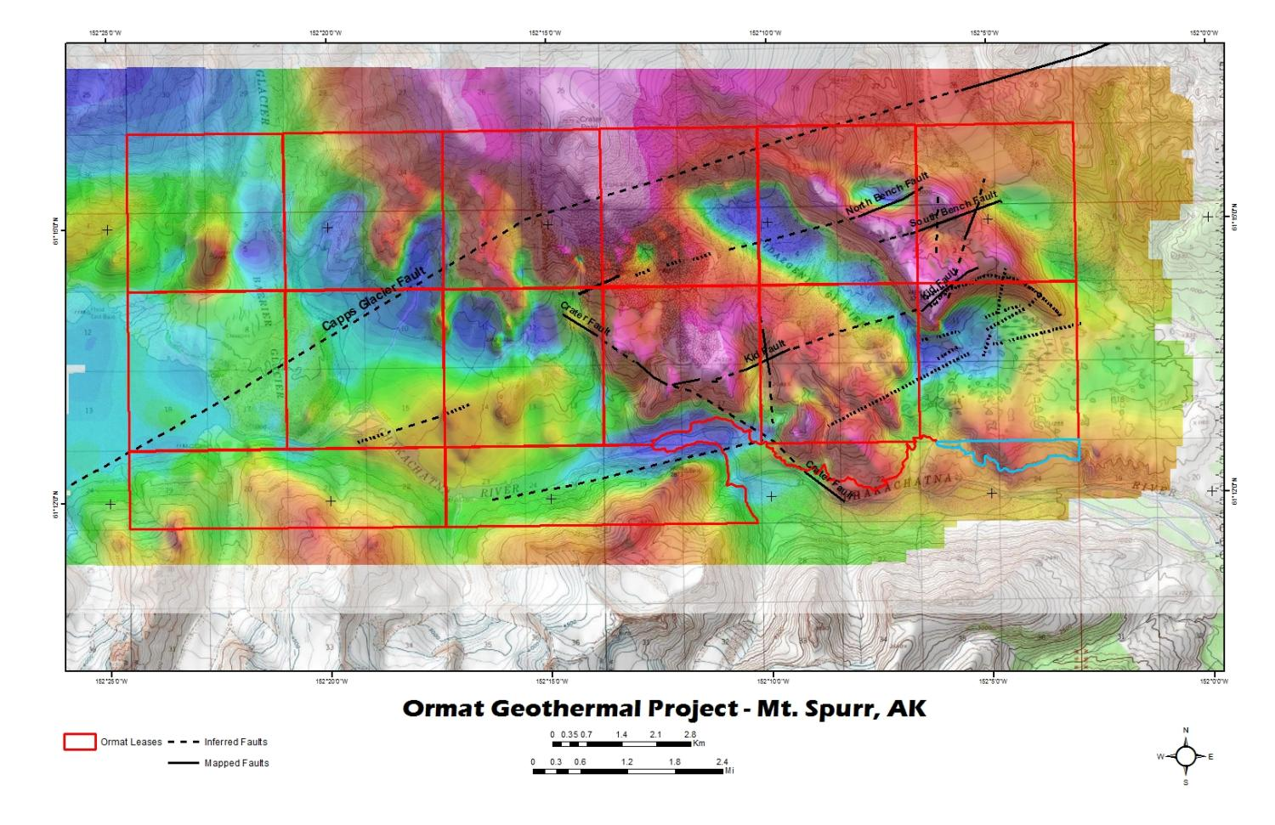
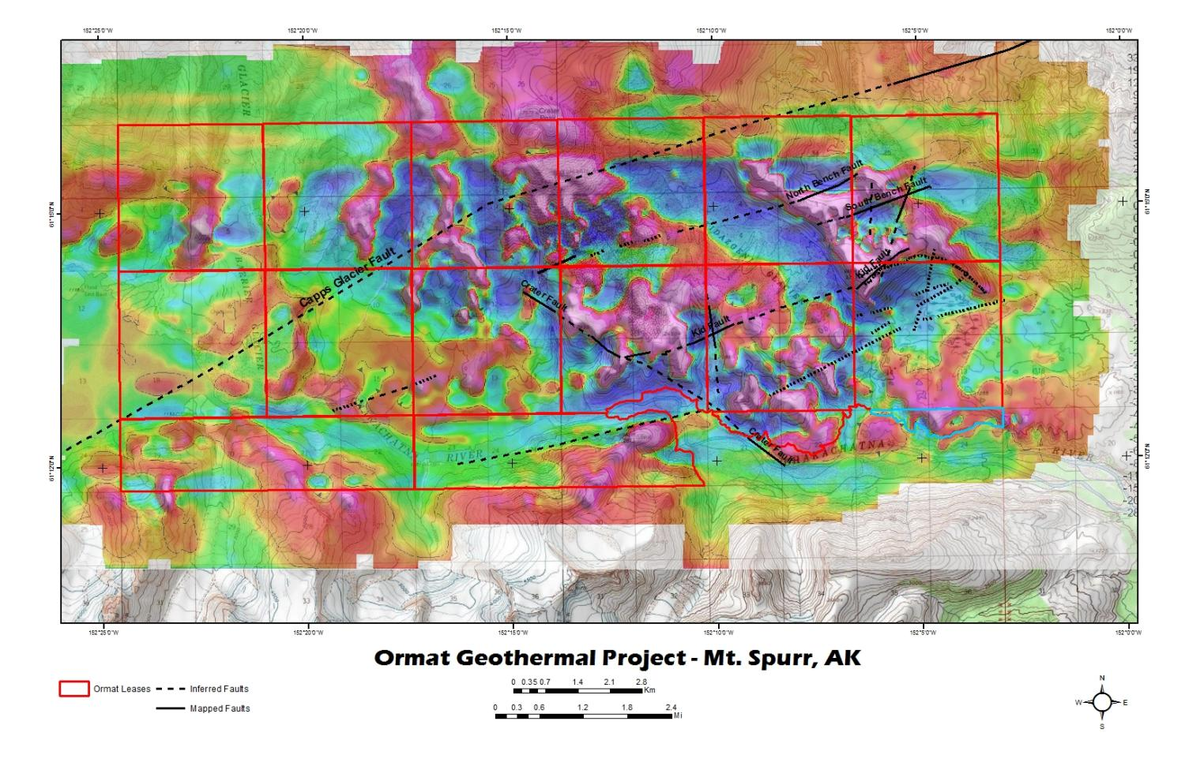
Geophysics – Heli-magnetics (RTP/FVD)
Airborne gravity gradiometry

Slide 13
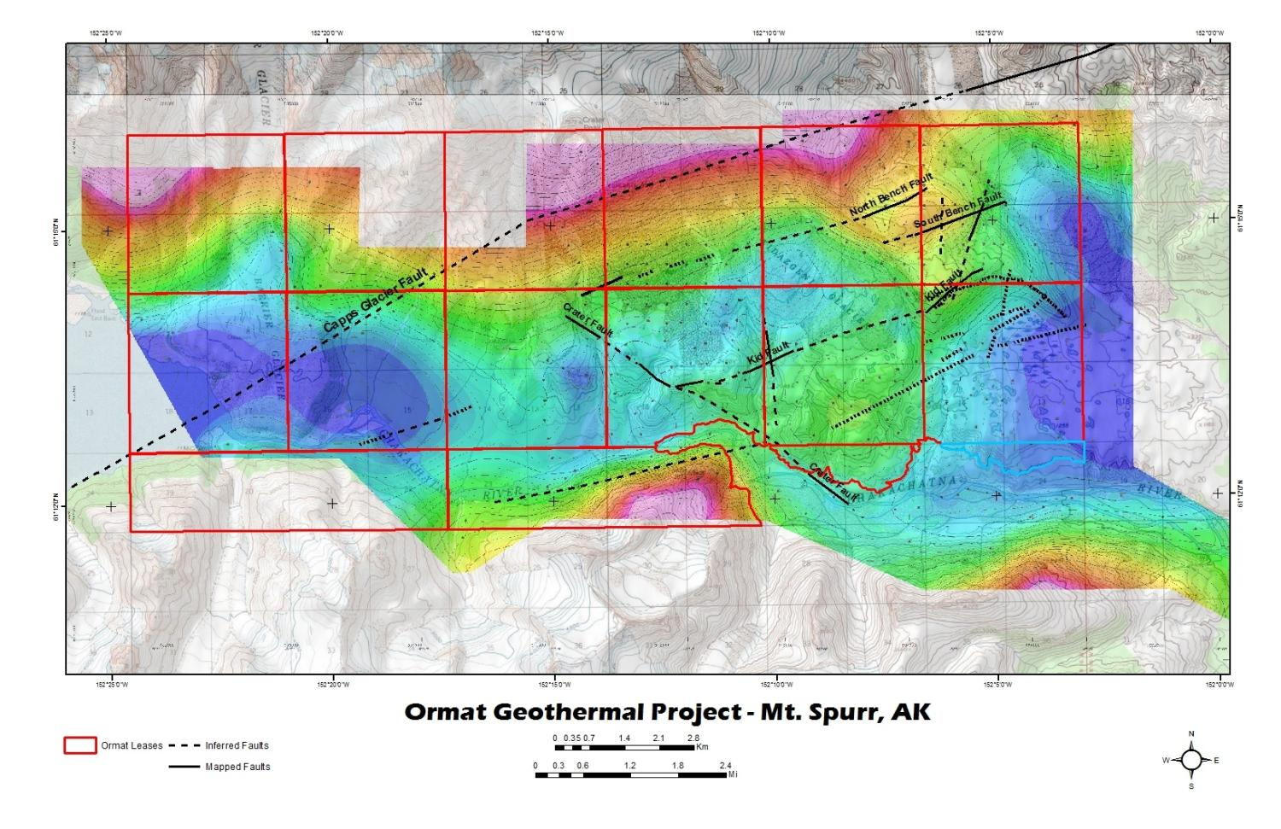
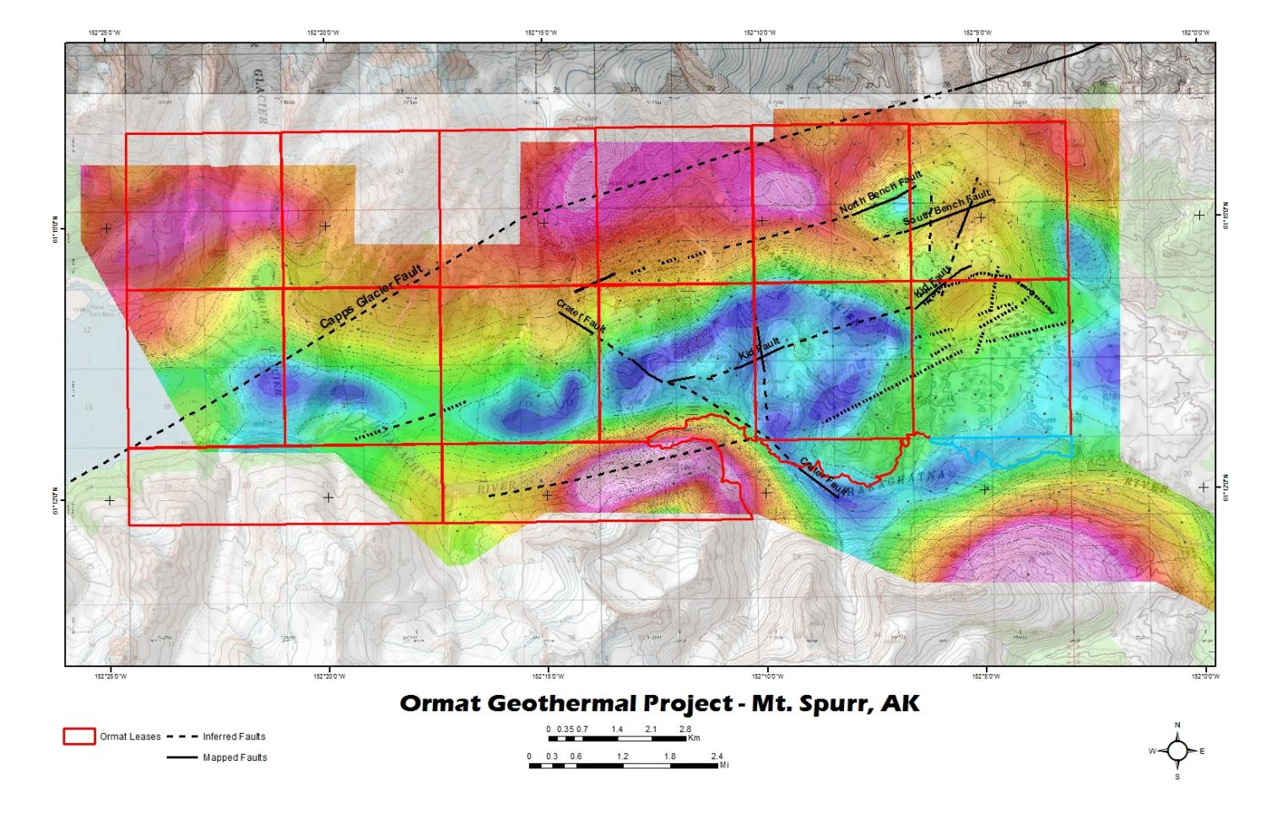
Geophysics – Bouger Gravity (Horizontal Gradient)
Airborne gravity gradiometry

Slide 14
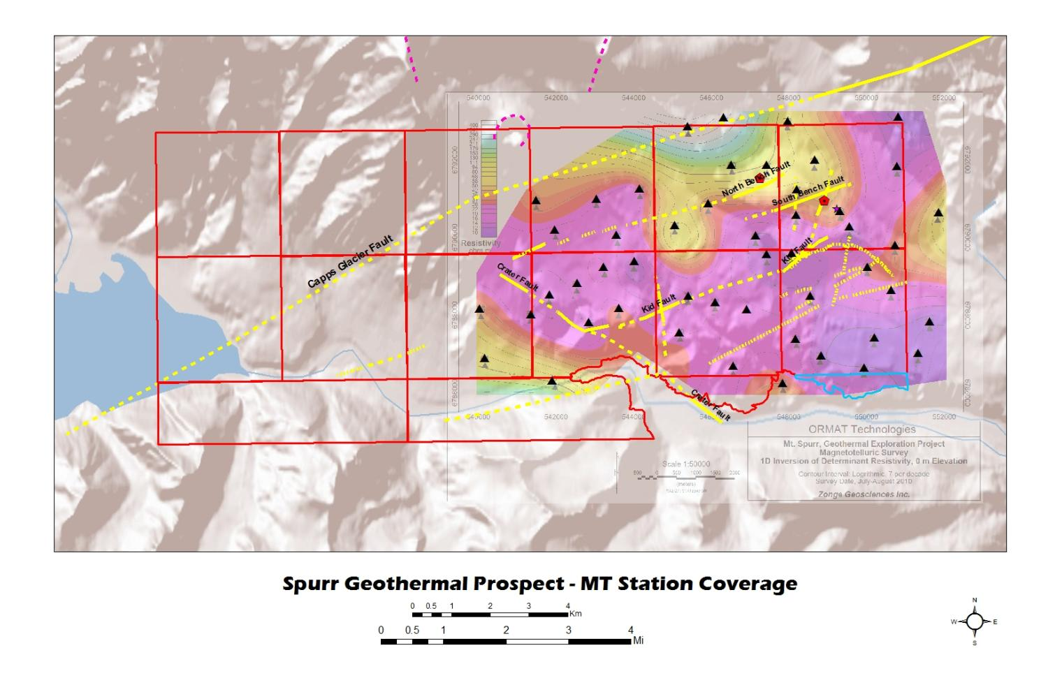
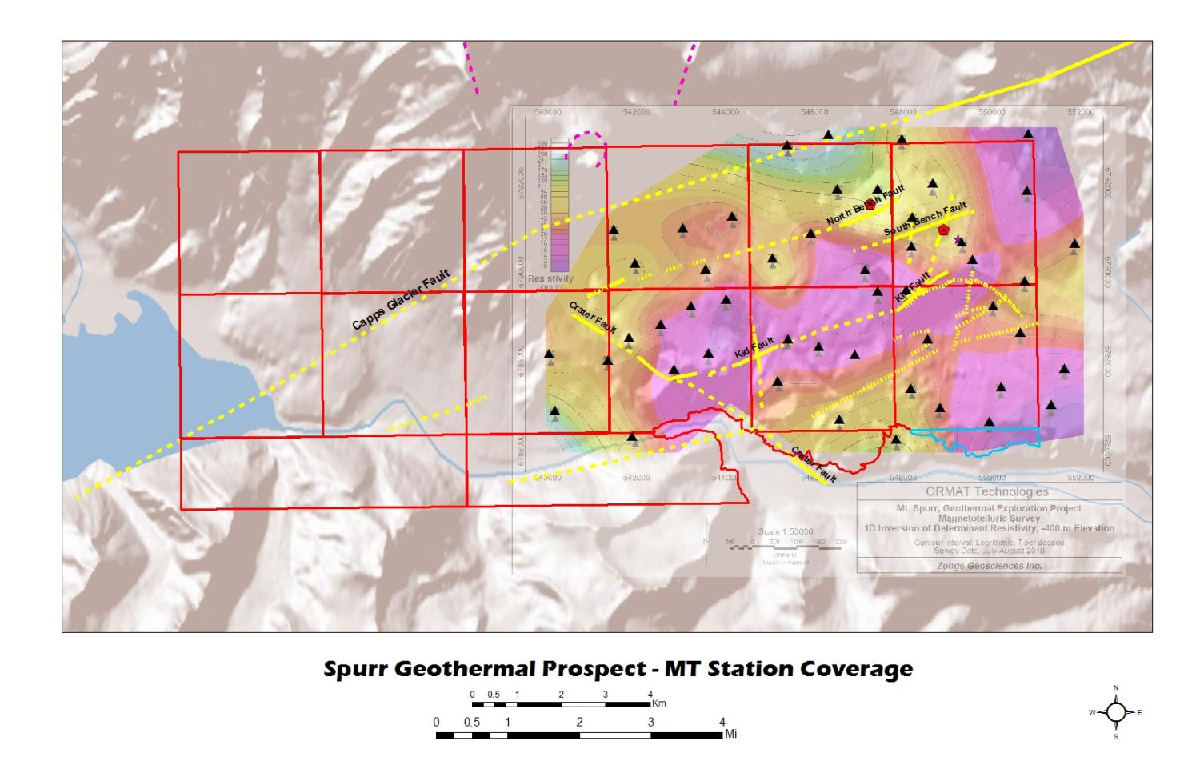
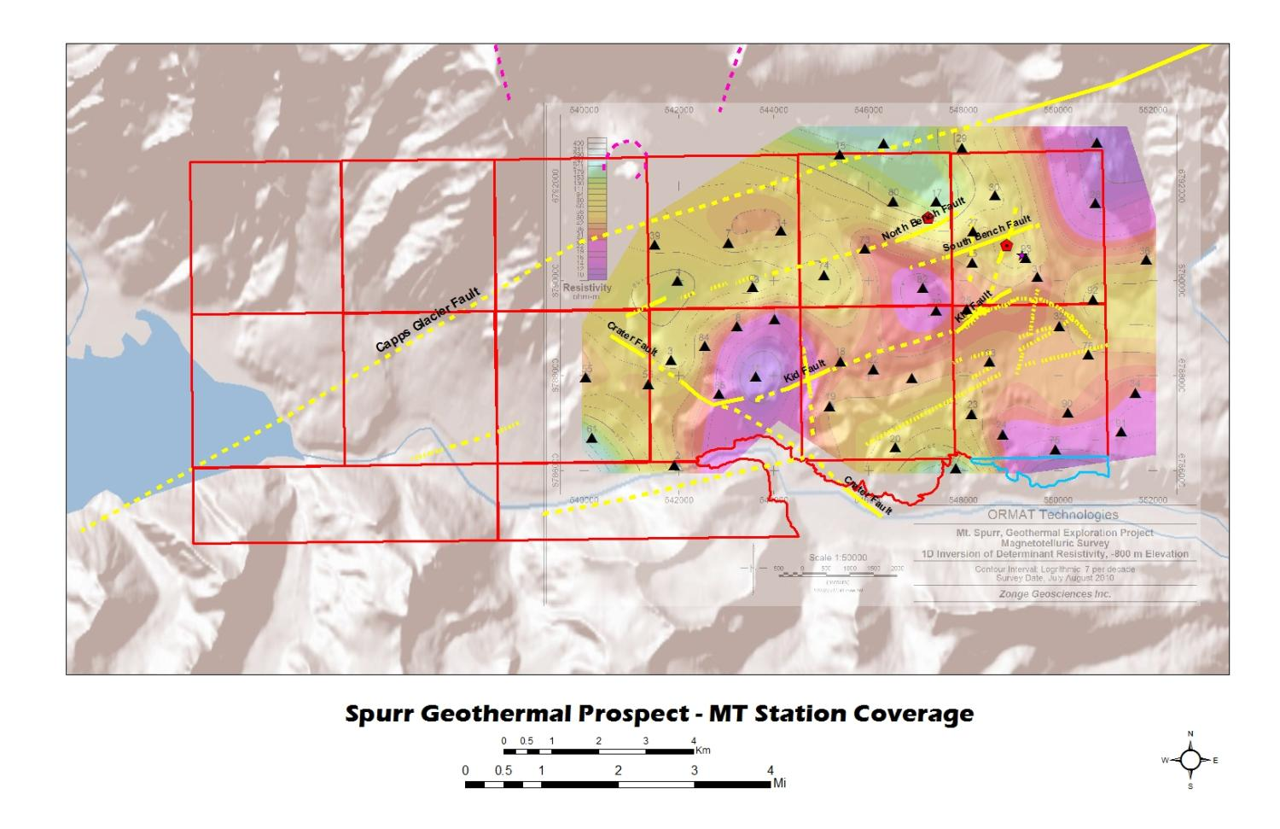
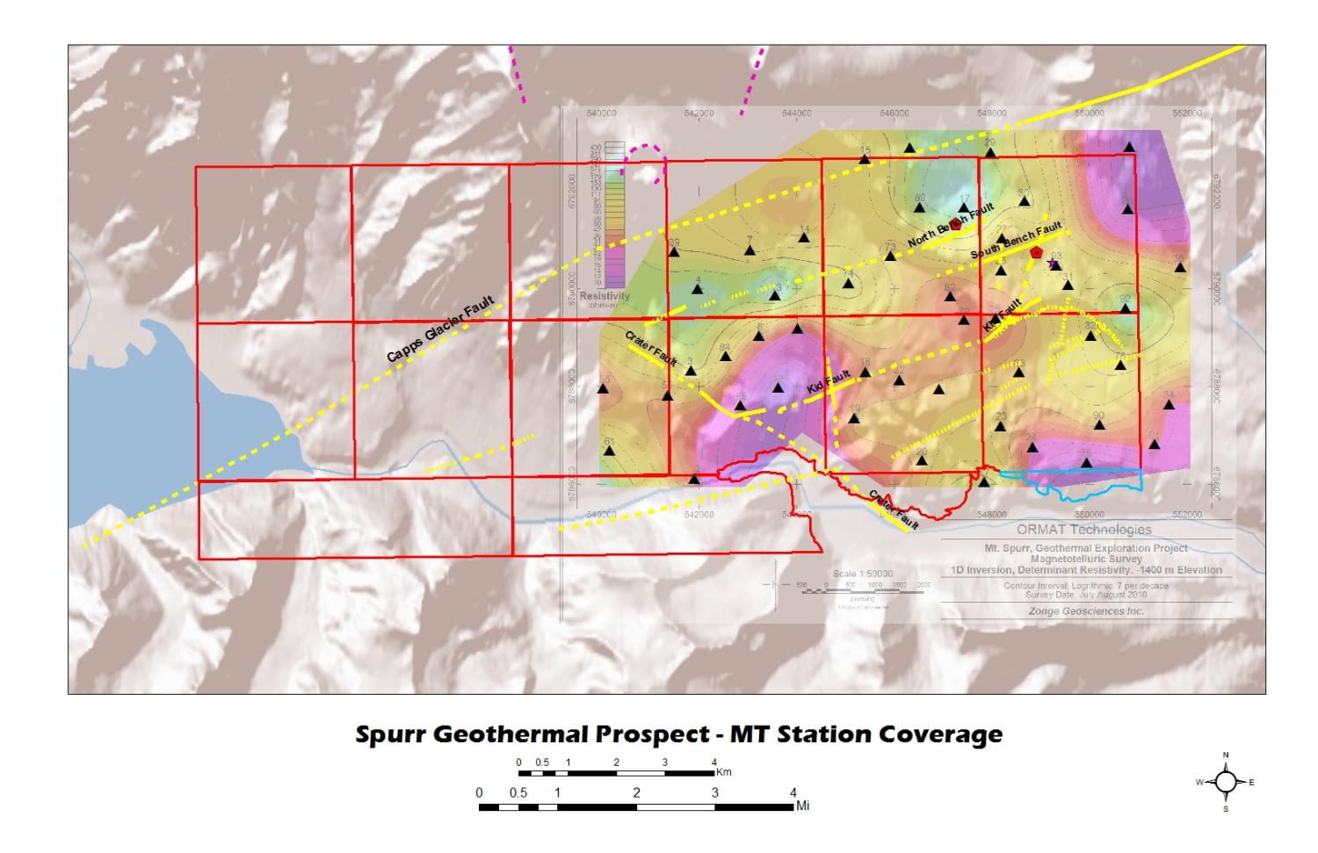
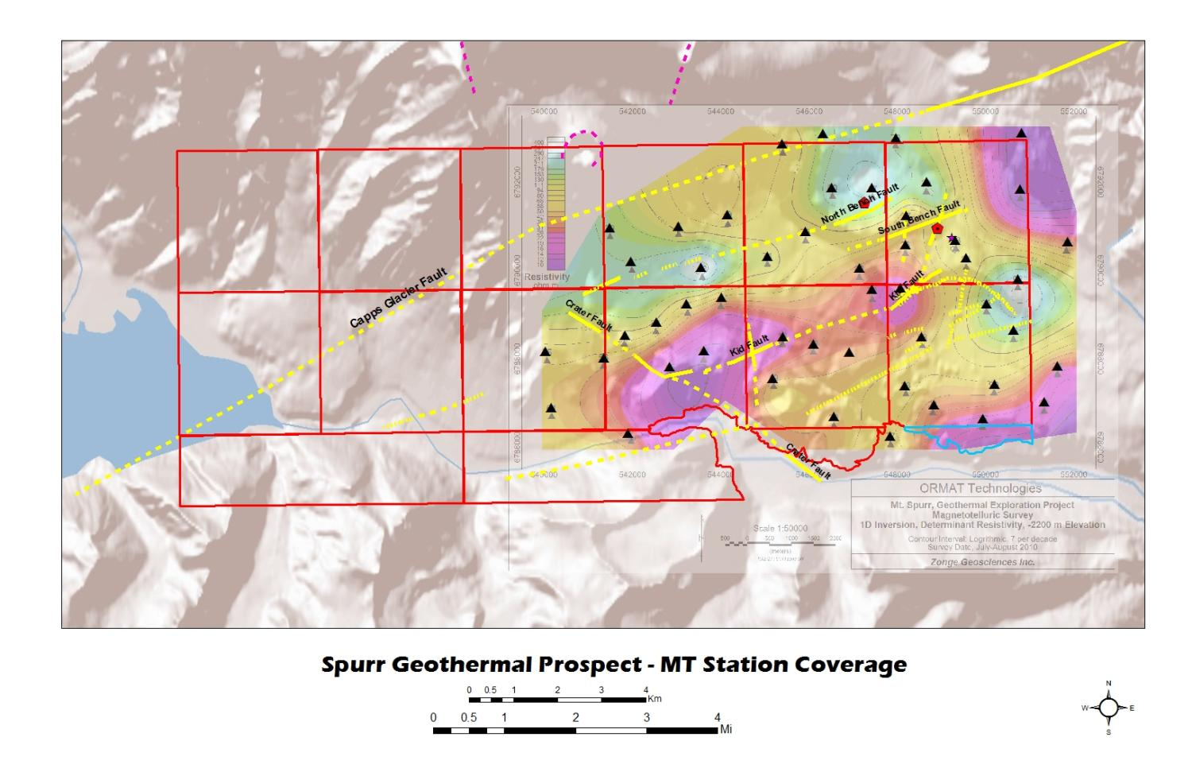
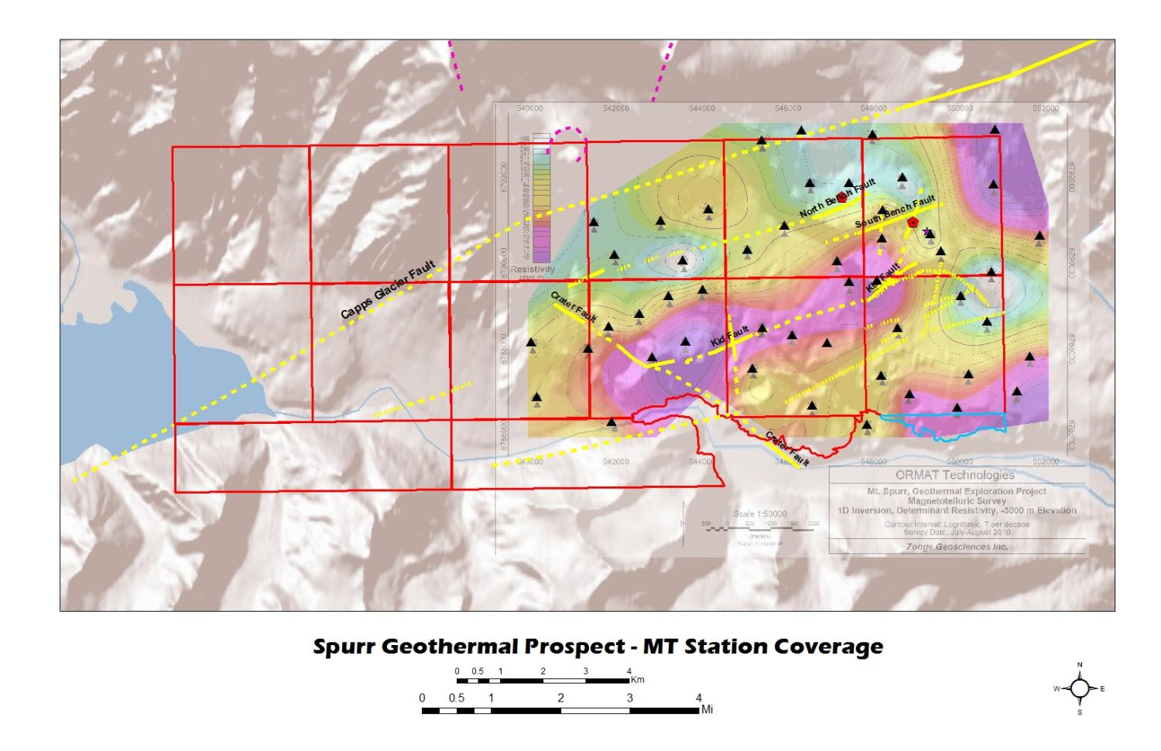

Geophysics – MT (0-4000 m below surface)

Slide 15
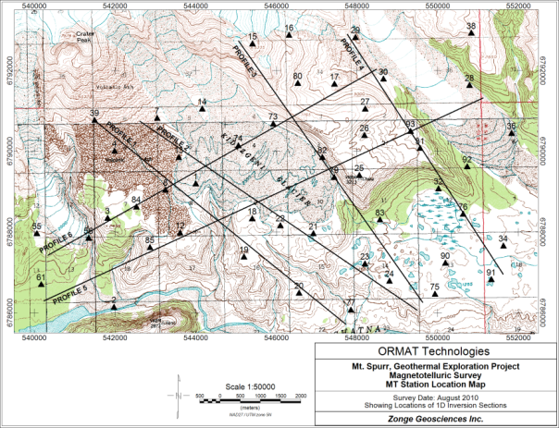
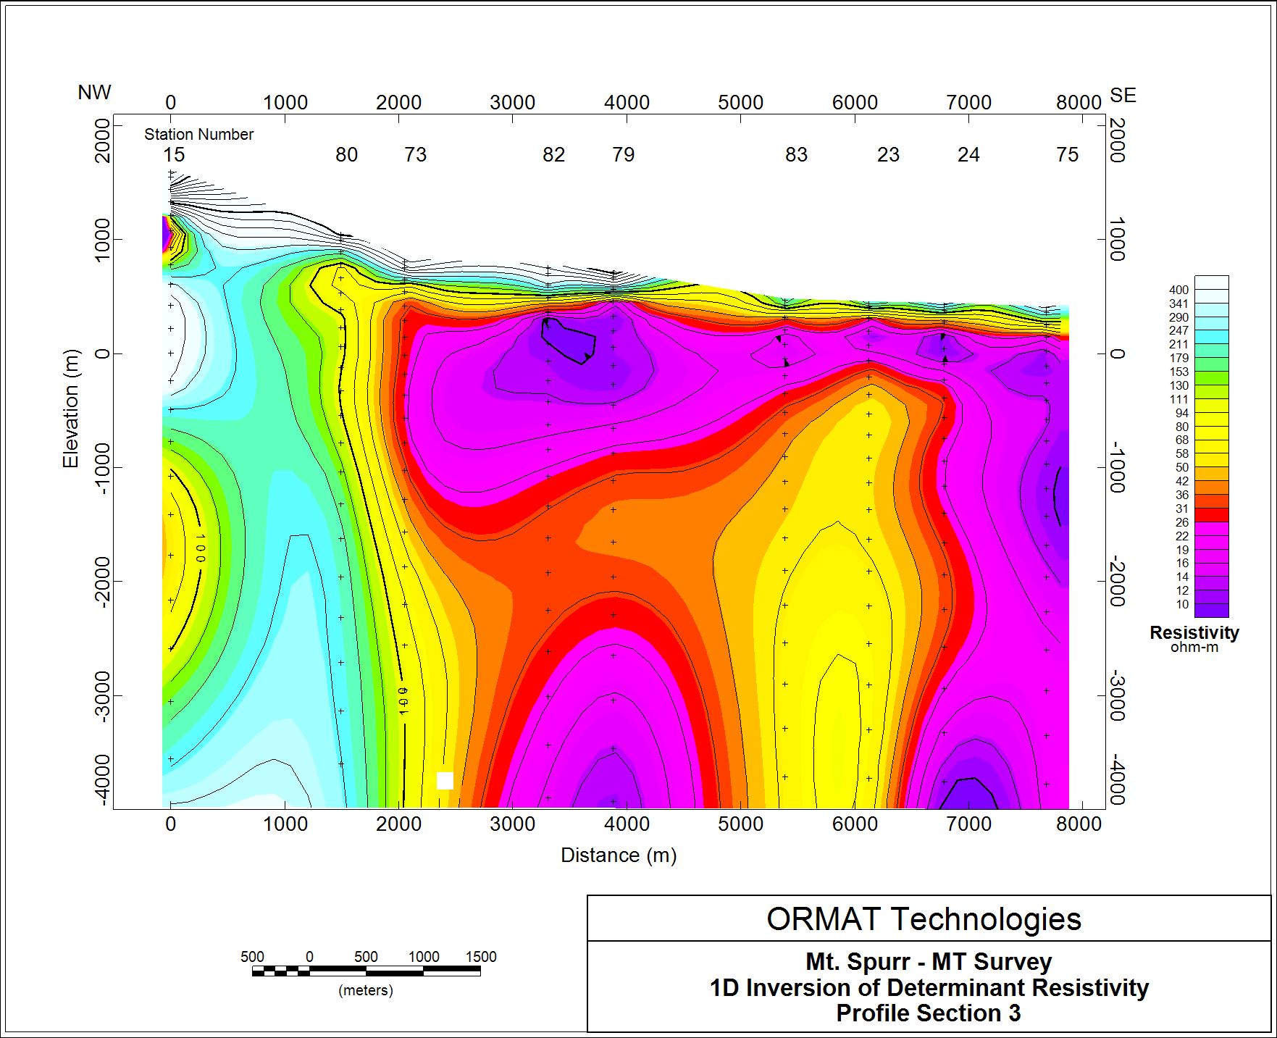
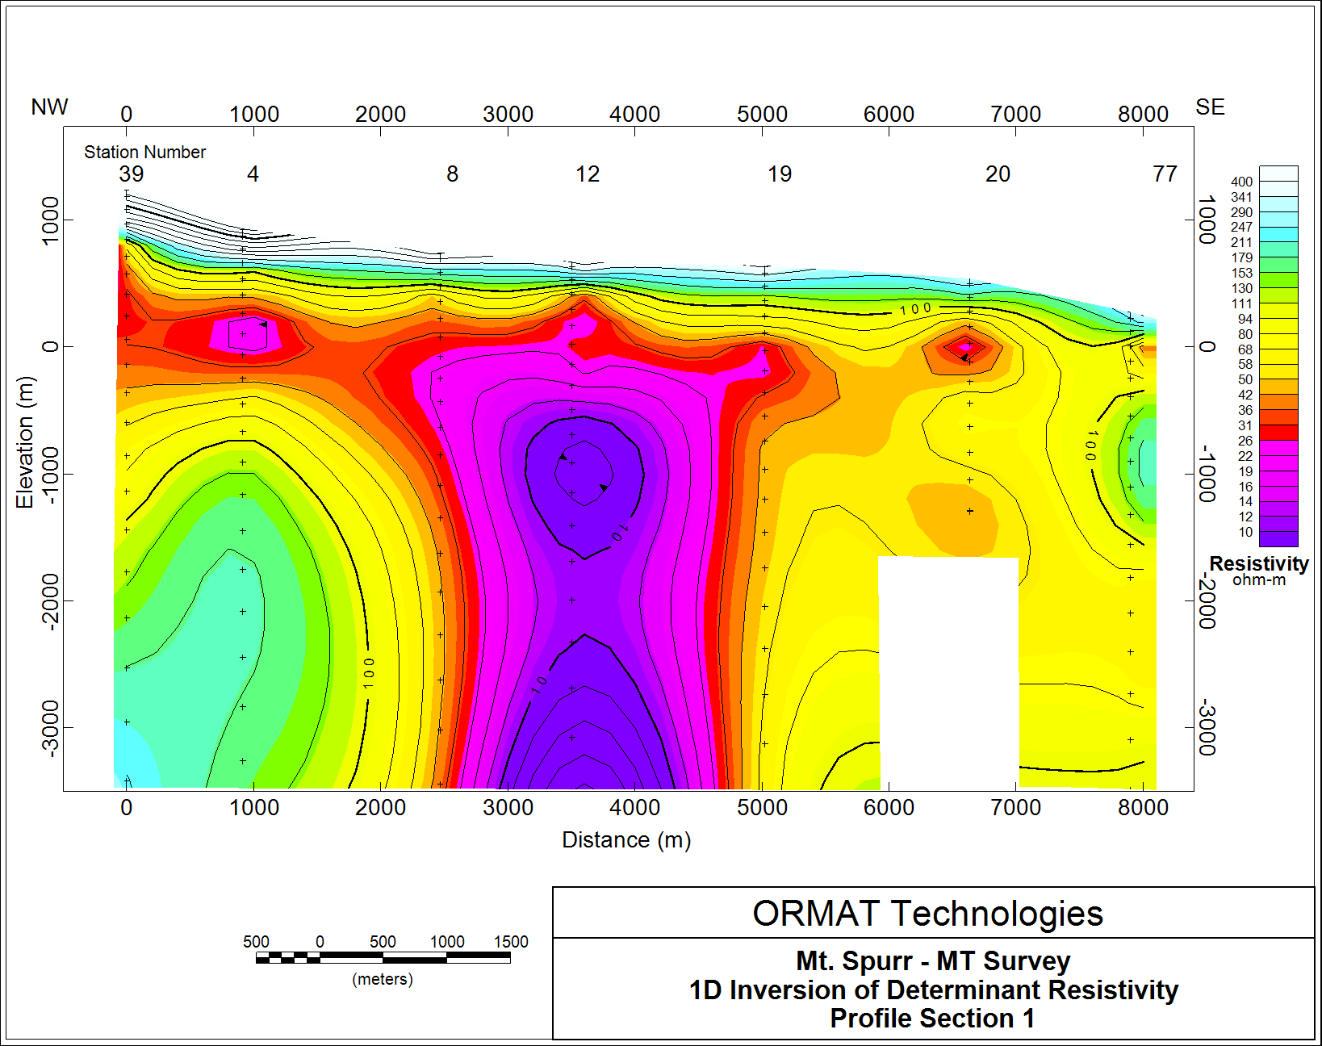
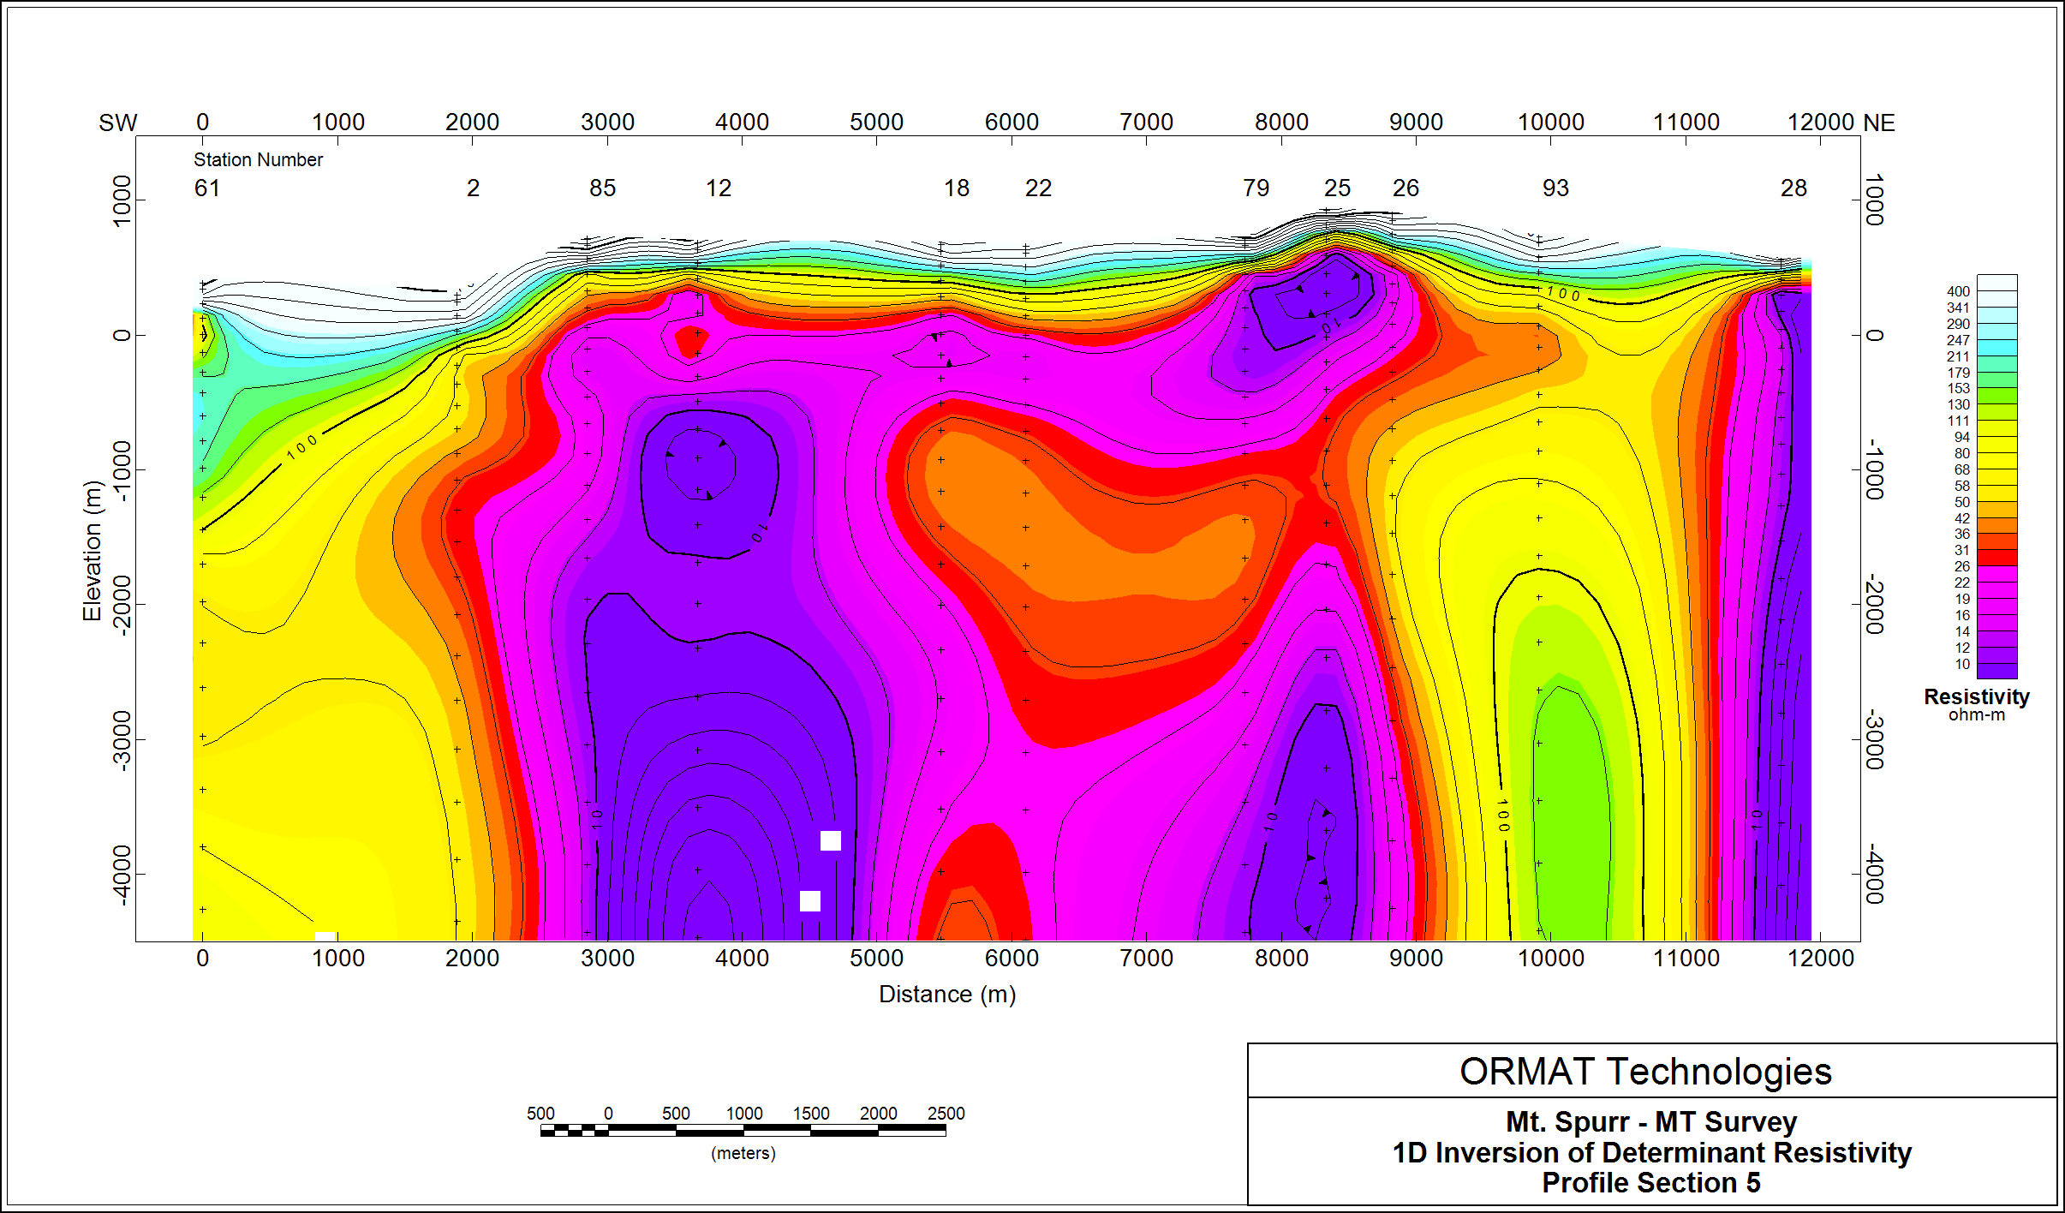
Geophysics – MT (1D slice)

Slide 16
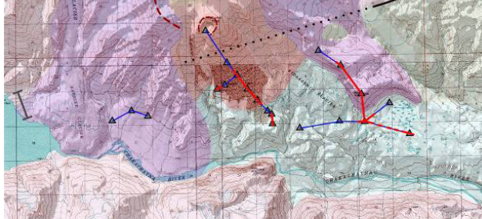
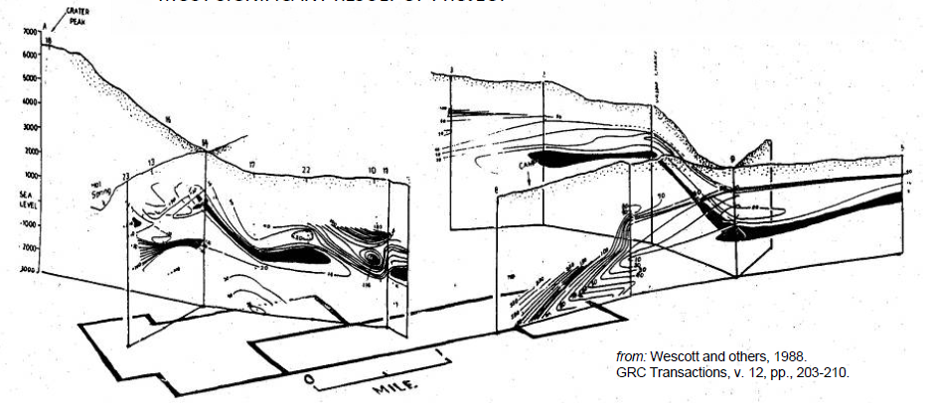
Resistivity with Depth – ‘Fence’ model

Slide 17
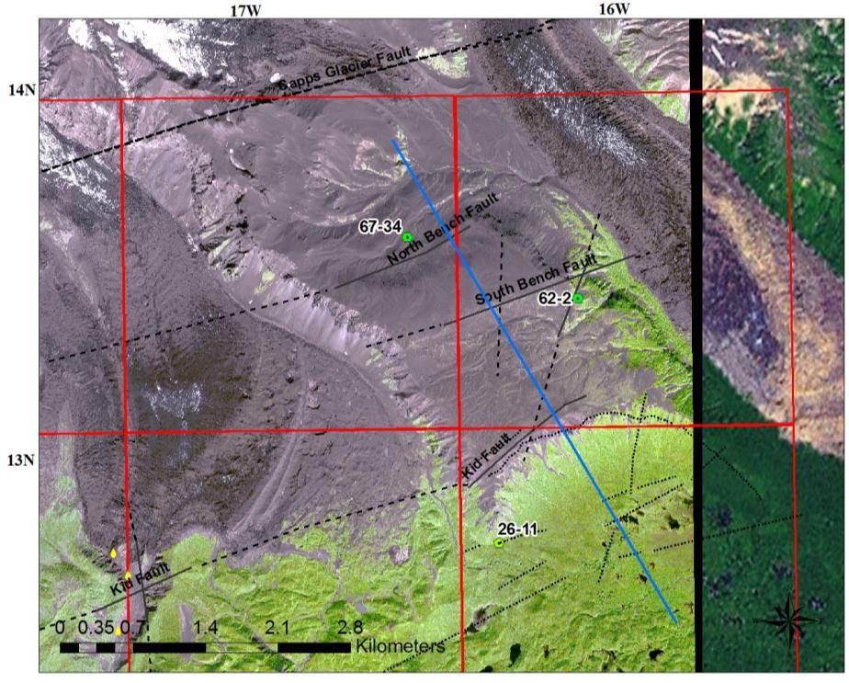
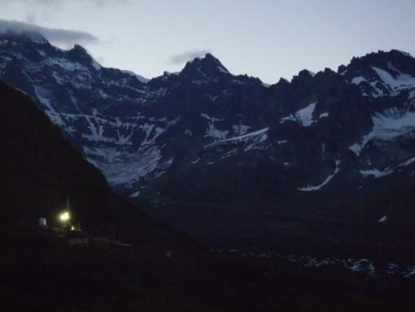
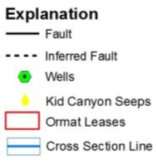
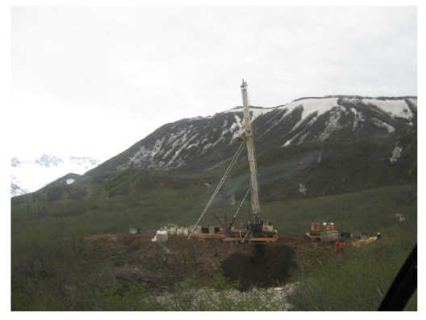
Mt. Spurr, AK – Working Cross Section

Slide 18
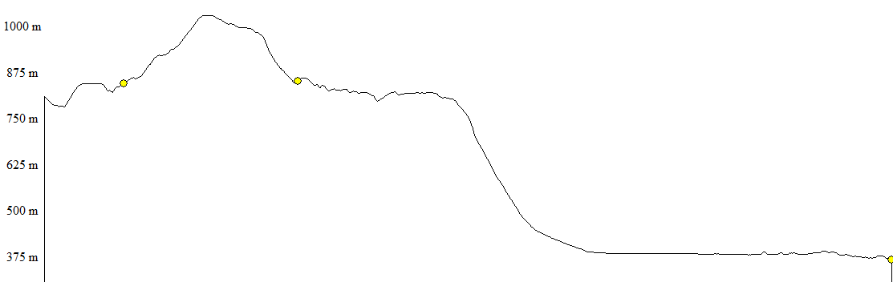
Mt. Spurr, AK – 2010/2011 – Fault model
67-34
62-2
Debris flow
Faults
Volcanics
26-11
1874-1894’
2580-2600’
3400-3600’
3988’ TD
Notes:
PQ cored to 452’ (through debris flow unit); set HWT casing
Drilled ahead with HQ to current depth of 3172’ (through predominately lower Westforeland Formation conglomerates and minor volcanic beds and ashes)
Deviation has continued to increase, slowly at first, and then a big jump after the last fault zone; currently at ~18deg.
Set HQ casing
Cored with NQ to 3988’, twisted off
Attempted to fish; unsuccessful – left ~700’ of rod in the hole

Slide 19
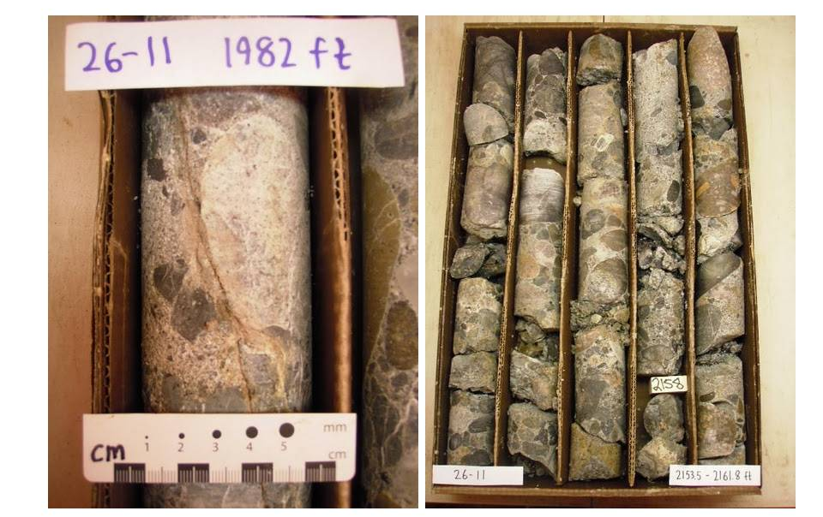
Lithology and Fracturing

Slide 20
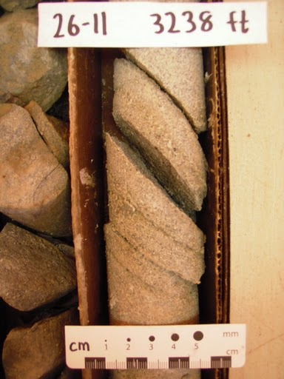
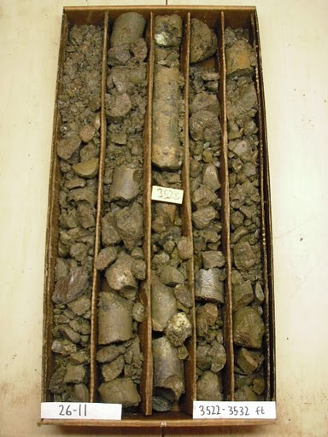
Lithology and Fracturing

Slide 21
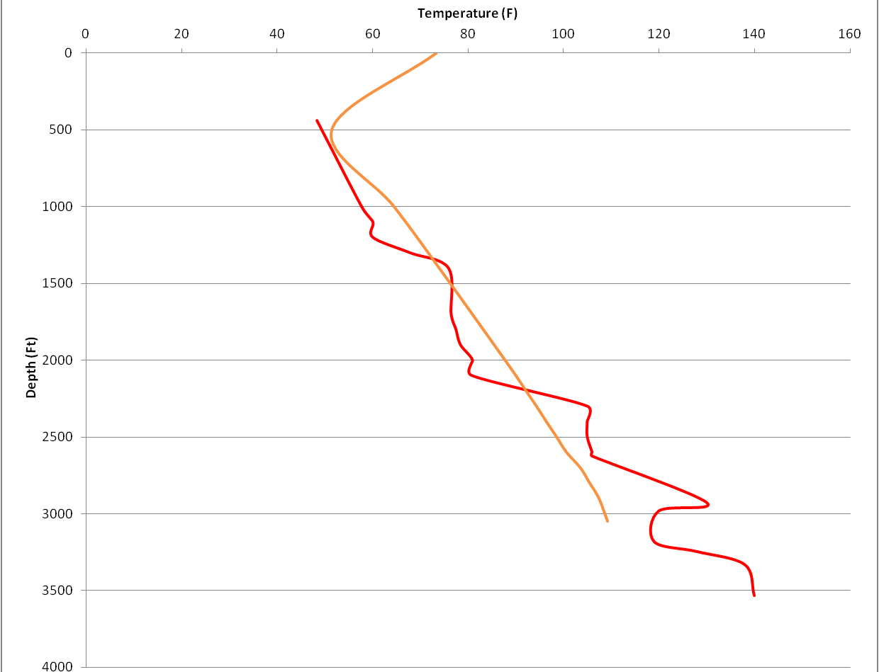
26-11 Gradient (MRT)
Un-equilibrated
Equilibrated
12F/100’
Overall (linear fit)
~3.8F/100
12F/100’
10F/100’
13F/100’

Slide 22
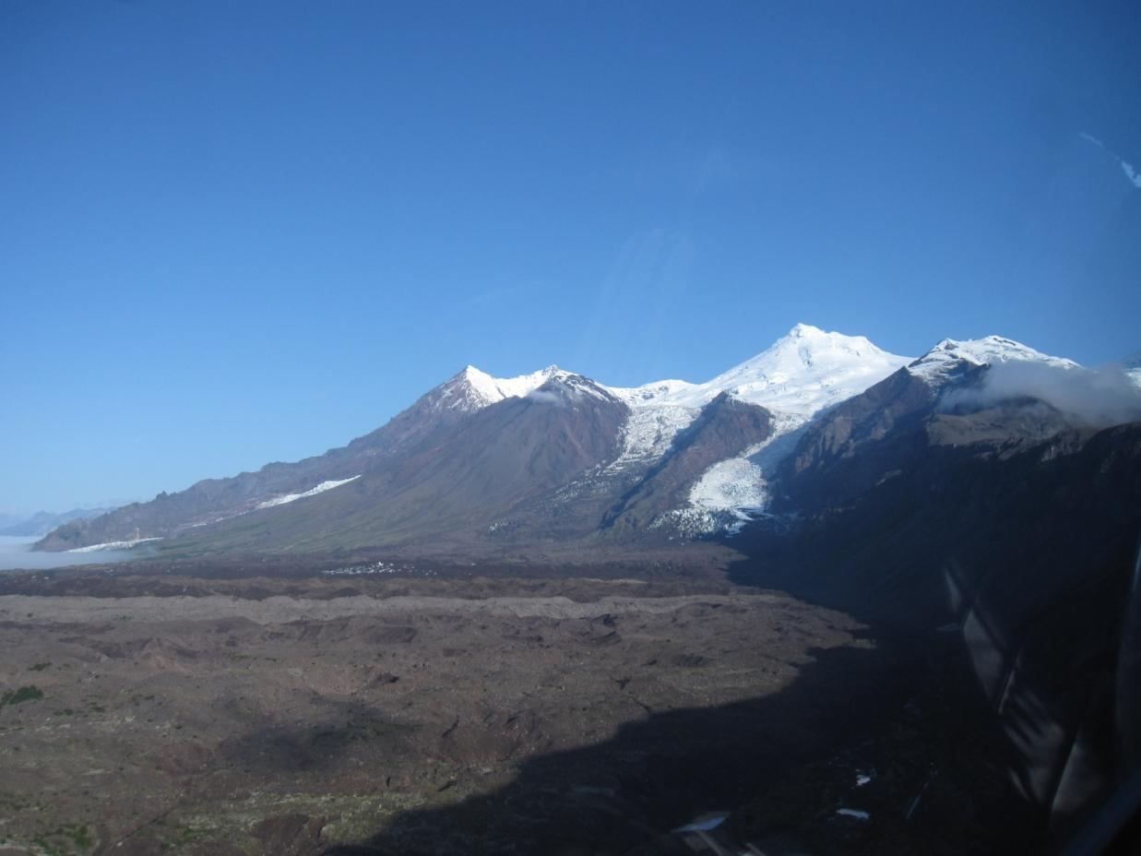
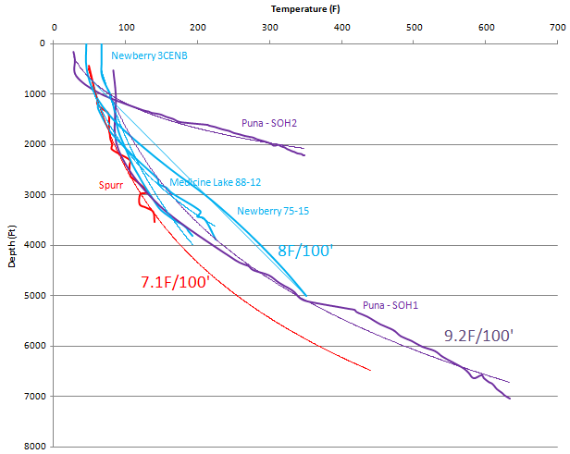
Massive thermal suppression?
Notes:
The geophysical combination of heli-mag, gravity and MT plus LiDAR has revealed structural complexity not previously identified in the Mt. Spurr region
This complexity echoes more regional structure and provides a framework for a hydrothermal system
Geochemistry indicates fluids issuing from these structures are a mix between Crater Lake endmember fluids (acidic) and the cold groundwater system fed by prolific glaciers in the area
2010 drilling confirmed fault zones and geothermal-like fluid at depth
Coincident zones of resisitivity, magnetic and gravity lows with large identified fault zones provides targets for intermediate depth (~3000-4000’) temperature gradient core holes in 2011

Slide 23
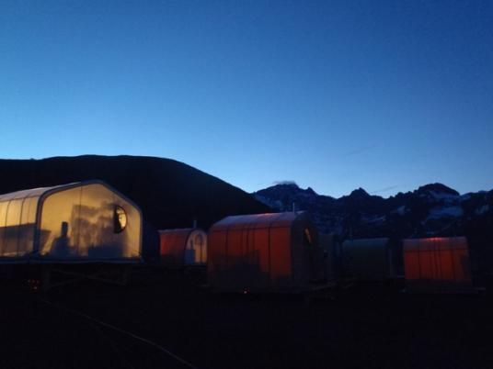
Mt. Spurr - Alaska
Thank you: AEA, AVO, DGGS, DNR,
AOGCC, AES, ENTriX,

